Slide 1




Predicting Crime Rates Using Machine Learning
Predictive analytics can help cities better understand and prevent crime. By analyzing historical crime data and using machine learning algorithms, we can identify potential crime hotspots and allocate resources accordingly.

Slide 2
Understanding the Problem: Analyzing Crime Data
Crime Trends
Crime Types
Resource Allocation
Crime data reveals patterns, seasonal variations, and geographic hotspots. Analyzing this data can help us understand the factors driving crime.
Different crime types have different characteristics and require different strategies for prevention. Identifying the most prevalent crime types is crucial.
Predictive models can help allocate police resources more effectively by identifying high-risk areas and times.

Slide 3

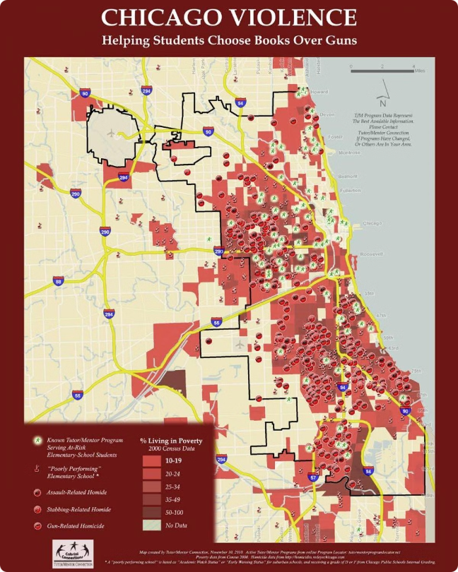
Gathering the Data: The Chicago Crime Dataset
1
Comprehensive Dataset
2
Detailed Information
Each record includes details like date, time, location, crime type, and arrest status.
The Chicago Crime Dataset contains over 6.5 million records of crimes committed in Chicago from 2001 to 2017.
3
Open Access
4
Real-World Insights
The dataset is publicly available on Kaggle, making it accessible for researchers and analysts.
This dataset provides valuable insights into crime patterns and trends in a large urban environment.

Slide 4

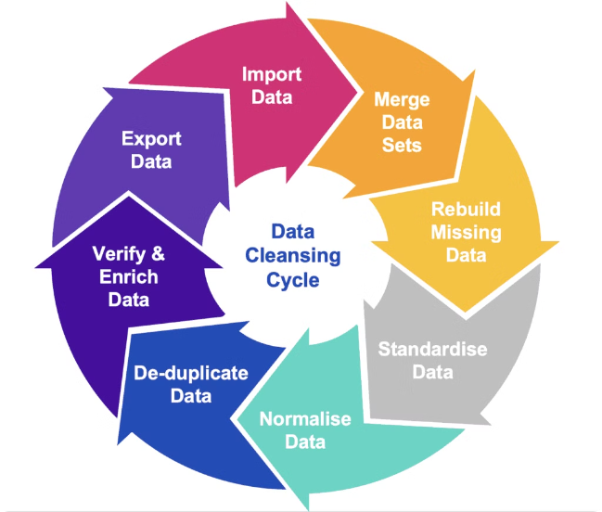
Preprocessing the Data: Cleaning and Transforming
1
Data Cleaning
This involves handling missing values, removing duplicates, and ensuring data consistency.
2
Feature Engineering
Creating new features from existing data, such as time of day, day of the week, or proximity to schools.
3
Data Transformation
Scaling or converting data into a format suitable for machine learning algorithms.

Slide 5

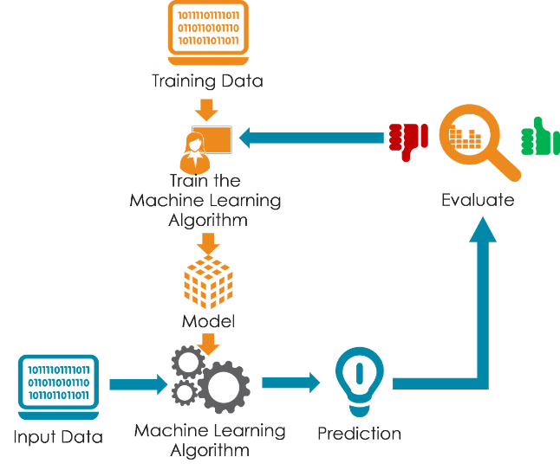
Selecting Machine Learning Algorithms
Regression Models
Classification Models
Predicting continuous values, such as the number of crimes expected in a specific area.
Classifying crimes into different categories, such as theft, assault, or drug offenses.
Clustering Algorithms
Grouping similar crimes together to identify patterns and understand underlying trends.

Slide 6

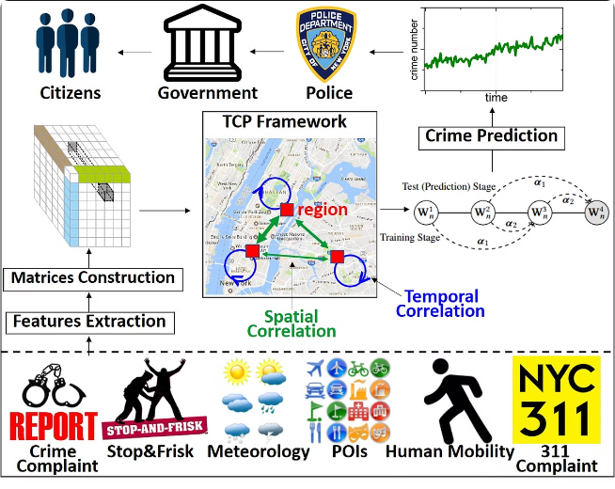



Training the Models: Predicting Crime Counts and Types
Model Training
Using the cleaned and transformed data to train the chosen machine learning models.
Model Evaluation
Assessing the performance of the trained models using metrics like accuracy, precision, and recall.
Model Optimization
Tuning model parameters and trying different algorithms to improve performance.

Slide 7

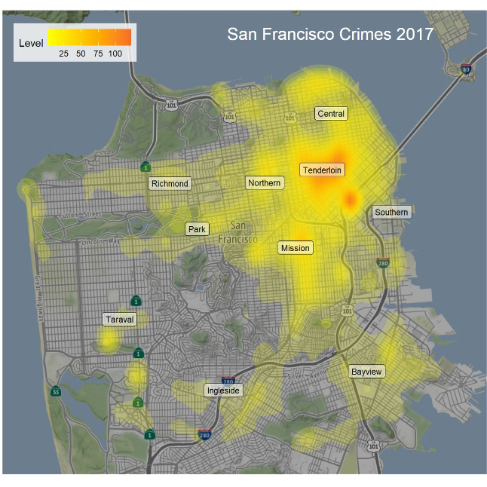
Interpreting the Results: Identifying High-Risk Crime Areas
Area
Predicted Crime Count
Crime Type
Downtown
High
Theft, Vandalism
South Side
Moderate
Assault, Robbery
West Side
Low
Drug offenses, Burglary

Slide 8

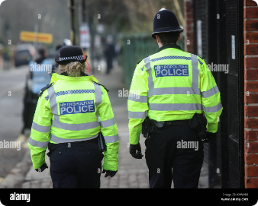




Conclusion: Leveraging Predictive Analytics for Crime Prevention
Resource Allocation
Public Awareness
Crime Prevention Strategies
Data-Driven Decisions
Predictive models can help allocate police resources more effectively to high-risk areas.
Understanding crime trends can help raise public awareness and promote safety measures.
Predictive analytics provides valuable insights for making informed decisions regarding crime prevention.
Predictive analytics can guide the development of targeted crime prevention programs.

Slide 9
Thank You

